Slide 1
Client-Server Systems in Database Management System
Presented by
Almora R. Kharkamni
MCA 4th Semester
Roll No :: 10

Slide 2
Contents
Introduction
Three Tier Client-Server Architecture
Presentation Layer
Application Layer
Database Server
Working
Advantages
Disadvantages
References

Slide 3
Introduction
A client is typically a user machine that provides user interface capabilities and local processing.
A server is a system containing both hardware and software that can provide services to the client machines, such as file access, printing, archiving, or database access.
When a client requires access to additional functionality such as database access that does not exist at that machine, it connects to a server that provides the needed functionality.

Slide 4
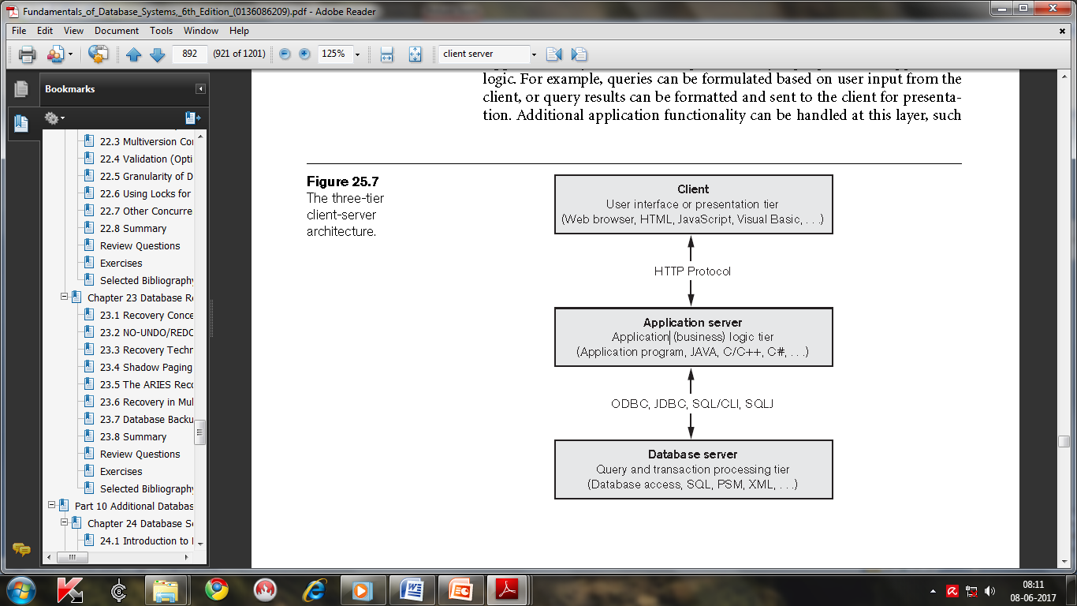
Three-Tier Client-Server Architecture

Slide 5
Three-Tier Client-Server Architecture
In the three-tier client-server architecture, the following three layers exist :
Presentation layer (client)
This provides the user interface and interacts with the user.
Web browsers are often utilized, and the languages used include Java, HTML, XHTML etc.
handles user input, output, and by accepting user commands and displaying the needed information, usually in Web pages.

Slide 6
Three-Tier Client-Server Architecture
Application layer (business logic)
This layer programs the application logic.
Functionality can be handled at this layer, such as security checks, identity verification, and other functions.
The application layer can interact with one or more databases or data sources as needed by connecting to the database using ODBC,JDBC,SQL/CLI etc

Slide 7
Three-Tier Client-Server Architecture
Database server
This layer handles query and update requests from the application layer, processes the requests, and sends the results.
Usually SQL is used to access the database
Query results may be formatted into XML when transmitted between the application server and the database server.

Slide 8
Working
The Client input a query in SQL or other languages.
The application server formulates the query and send to appropriate database server.
The database server processes the query and sends the results to the application server.
The application server formats it into HTML or some other form accepted by the client, and sends it to the client site for display.

Slide 9
Advantages
Client-Server System has less expensive platforms to support applications.
Client offer icon-based menu-driven interface.
A single database on server can be shared across several client systems.
The system improves functionality and simplicity.

Slide 10
Disadvantages
The system creates a more complex environment that are difficult to manage.
The time cost of communication between the client and the server is high.
Lack of management tools for security control and networking environments.

Slide 11
References
Fundamentals of Database Systems, 6th Edition,
page no. 892-893
http://www.ecomputernotes.com

Slide 12
Thank You

